Slide 1



Presentation
On
LIBRARY MANAGEMENT SYSTEM
Bachelor of Technology
In
Information Technology
Dr. A.P.J. Abdul Kalam Technical University , Lucknow (Uttar Pradesh)
Group Member’s
Under the Supervision
Ankur Chaudhary
Assistant Professor
Roll Number | Student Name | Role & Responsibilities
2301330130104 | Manorath Singh | Project work
2301330130092 | Janhvi Srivastava | Project work

Slide 2
Table of Content
Capstone Project Title
Introduction
Literature Survey
Software Requirement Specification(SRS)
Software Design Specification
Implementation & Coding
Testing of Software
Result & Output
Conclusion / Recommendations
Future Scope
References (IEEE Format)

Slide 3
1. Introduction
  1.1 Overview
  1.2 Purpose
  1.3 Scope
  1.4 Objectives/Project Design Aim

Slide 4
Overview
A Library Management System (LMS) is a software application designed to manage and streamline the day-to-day operations of a library. It helps librarians and library staff organize, maintain, and access information about books and other library resources efficiently.
One of the key advantages of an LMS is that it significantly reduces the time and effort involved in manual library operations, thereby improving accuracy and productivity. Users can easily search for books by title, author, subject, or ISBN, while librarians can quickly update inventory, manage book reservations, and monitor book availability in real-time.

Slide 5
1.2 Purpose
The purpose of the Library Management System is to simplify and automate the management of a library’s resources, including books, users, and transactions. It aims to reduce manual efforts, minimize human errors, and provide a centralized platform for efficient library operations.
1.3 Scope
The system is designed for libraries of schools, colleges, or public institutions. It includes functionalities such as adding and updating book records, managing user accounts, issuing and returning books, fine calculation, and generating reports. The system supports both librarian and member interfaces, with user authentication and role-based access.
1.4 Objectives / Project Design Aim
To enable quick and efficient tracking of books and user activities.
To implement a secure login system for both users and administrators.
To reduce paper-based work by digitalizing library records.
To provide accurate, real-time information about book availability and user transactions.
To develop a user-friendly interface for managing library tasks.
1.4 Objectives / Project Design Aim
To develop a user-friendly interface for managing library tasks.
To enable quick and efficient tracking of books and user activities.
To implement a secure login system for both users and administrators.
To reduce paper-based work by digitalizing library records.
To provide accurate, real-time information about book availability and user transactions.

Slide 6
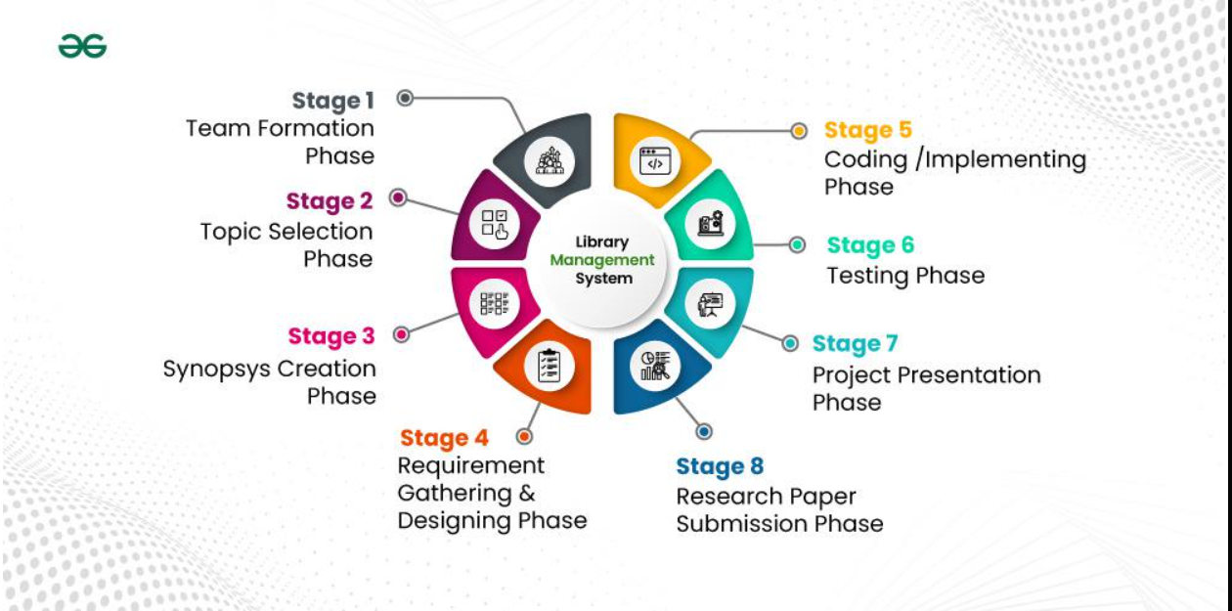
2. Literature Survey/Literature Review
2. Literature Survey/Literature Review
or user experience. There is a need for a reliable system that automates these processes for better management and accessibility.
Prob2.1 Problem Definition
The current manual system used in many libraries leads to inefficiencies such as time-consuming record-keeping, frequent human errors, difficulty in tracking book status, and poor user experience. There is a need for a reliable system that automates these processes for better management and accessibility.
l Definition
The current manual system used in many libraries leads to inefficiencies such as time-consuming record-keeping, frequent human errors, difficulty in tracking book status, and poor user experience. There is a need for a reliable system that automates these processes for better management and accessibility.
Problem Definition
The current manual system used in many libraries leads to inefficiencies such as time-consuming record-keeping, frequent human errors, difficulty in tracking book status, and poor user experience. There is a need for a reliable system that automates these processes for better management and accessibility.

Slide 7
3. Software Requirement Specification(SRS)
🔁 SDLC Model: Agile
Iterative development with continuous feedback
Suitable for dynamic and evolving systems
🧩 Functional Requirements:
Use Cases: Search books, issue/return, admin controls
Features: Catalog , user management, fine calculation
UI: Simple menus, dashboards, clean forms
🔒 Non-Functional Requirements:
Performance: Fast and scalable
Security: Role-based access, data encryption
Usability: User-friendly interface
Maintainability: Modular, easy to update

Slide 8
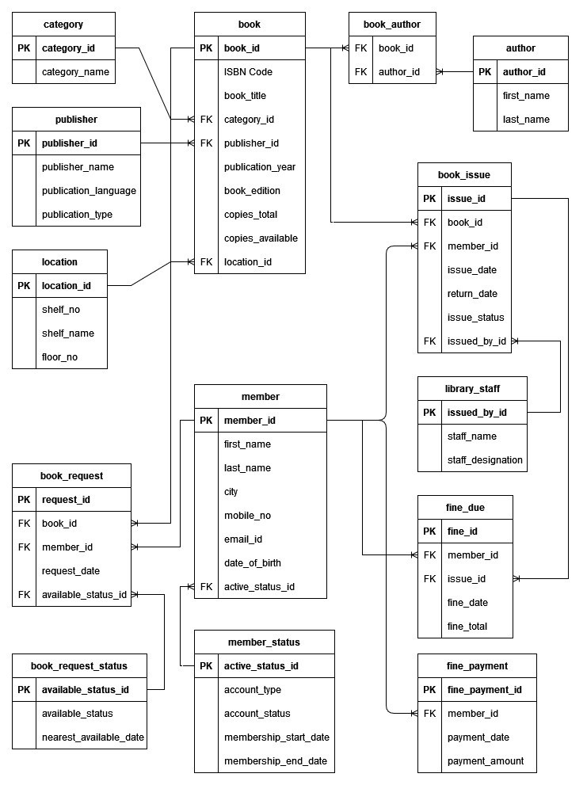
4. Software Design Specification
  ER DIAGRAM

Slide 9
5. Implementation & Coding
Details of Data Source
The data source for the Library Management System is a MySQL database which stores:
Books Data: Book ID, Title, Author, Publisher, ISBN, Category, Availability
Users Data: User ID, Name, Email, Password (encrypted), Role (admin/user)
Transactions: Issue/Return records, Dates, Fines
Login/Authentication Logs: Time-stamped login sessions for security auditing
Data is accessed using SQL queries and managed through backend scripts (PHP/Java/Python).

Slide 10
🔹 User Login Validation (PHP example):
if(isset($_POST['login'])) {
$email = $_POST['email'];
$password = md5($_POST['password']);
$query = "SELECT * FROM users WHERE email='$email' AND password='$password'";
$result = mysqli_query($conn, $query);
if(mysqli_num_rows($result) == 1) {
$_SESSION['user'] = $email;
header('Location: dashboard.php');
}
}
🔹 Book Issue Logic:
INSERT INTO transactions (user_id, book_id, issue_date, return_date)
VALUES (1, 101, CURDATE(), NULL);

Slide 11
6. Testing of Software
✅ Software Testing – Library Management System
🔹 Objective: Ensure the system works as expected, is secure, and user-friendly.
🧪 Types of Testing:
Unit Testing: Checked individual modules (e.g., login, book issue).
Integration Testing: Verified data flow between modules.
System Testing: Tested complete workflows end-to-end.
UAT (User Acceptance): Feedback from real users (librarians/admins).
Security Testing: Ensured data protection and access control.
Performance Testing: Tested speed and load handling.
🛠 Tools Used:
Manual testing, XAMPP/WAMP (for PHP & MySQL), Browser Dev Tools

Slide 12
  7. Results / Outputs
✅ Results and Output – Library Management System
🔹 Results:
The system successfully automated core library tasks such as:
  Book search, issue, return, and renewals
  Fine calculation and overdue tracking
  User registration and login
All modules (User, Book, Transaction, Admin) worked as expected.
Errors were reduced significantly compared to the manual process.
🔹 Sample Outputs:
Login Screen: Validates user credentials and redirects to dashboard.
Book Search Result: Displays filtered books by title/author/category.
Issue Confirmation: Shows transaction ID and due date.
Admin Dashboard: Summarizes total books, issued books, users, and fines.
Report Generation: Outputs PDF or printable reports for admins.

Slide 13
  8. Conclusion / Recommendations
Conclusion & Recommendations – Library Management System
✅ Conclusion & Recommendations –
🔚 Conclusion:
The Library Management System successfully automates library tasks, improves data accuracy, and enhances user experience. It reduces manual workload, speeds up operations, and ensures secure and organized management of resources.
💡 Recommendations:
Integrate barcode scanning for faster transactions.
Add mobile app support for wider accessibility.
Implement cloud backup for data security.
Include AI-based book recommendations for users.

Slide 14
9. Future Scope
Here’s a concise and clear version of the Future Scope for a Library Management System
🔮 Future Scope – Library Management System
📱 Mobile App Integration: Develop Android/iOS apps for easier access on the go.
📦 RFID/Barcode Integration: Speed up book issue/return with scanning technology.
☁️ Cloud-Based System: Enable remote access, auto-backups, and scalability.
🤖 AI Features: Smart book recommendations, chatbots for user support.
📊 Advanced Analytics: Generate detailed usage and trend reports for decision-making.
🔒 Enhanced Security: Multi-factor authentication and role-based access control.

Slide 15
10. References
📚 References – Library Management System
Sharma, S. (2020). Library Automation in Modern Libraries. International Journal of Library Science.
Rajeev, R. et al. (2019). Design and Implementation of Library Management System using PHP and MySQL.
Kumar, A. (2022). AI Integration in Library Management Systems. Journal of Emerging Technologies.
Meena, P. & Gupta, R. (2021). Comparative Study on Traditional vs Automated Libraries.

Slide 16
Thank You

